Slide 1
Expense Manager Website
MINI PROJECT- 1st
SESSION:2020-21

Slide 2
Group Members
Naman Maheshwari (181500411)
Nikhil Baghel (181500424)
Mentor: Anand Gupta Sir

Slide 3
Objective
The objective is to build a simple expense manager web application that can be used by all for tracking their expenses accordingly.

Slide 4
About this project
In this project, The user can add the initial budget for the expenses and give it a title accordingly. Further user can add bills under the given budget and track her expenses accordingly.The website will contain the following pages:
1. Index Page 6. Add New Plan Page
2. Sign up Page 7. View Plan Page
3. Login Page 8. Expense Distribution Page
4. About Us Page 9. Add New Expense Page
5. Home Page 10. Change Password Page

Slide 5
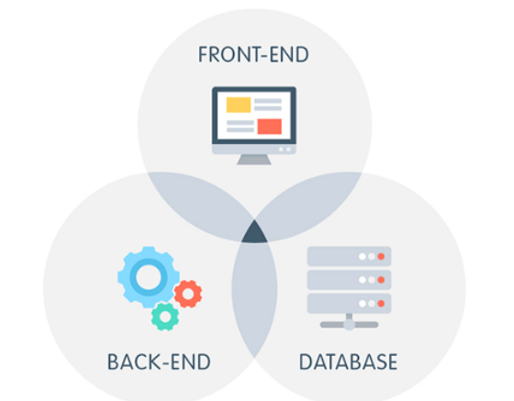
This project is based on Web development. Web development is the work involved in developing a Web site for the Internet (World Wide Web) or an intranet (a private network)

Slide 6
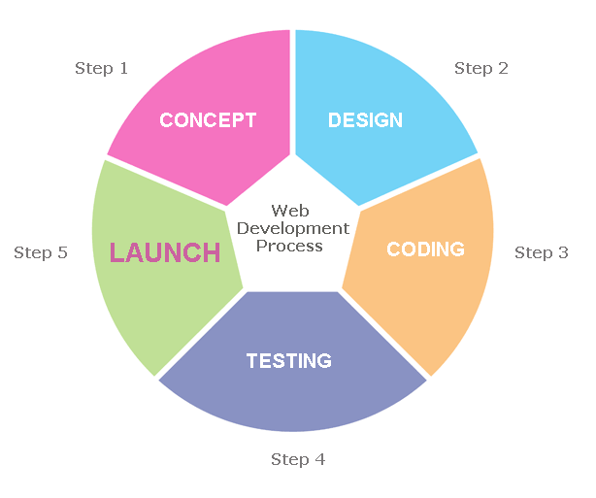
This figure showing the different steps involved in Web development process

Slide 7
Software and Hardware Requirements
Hardware : PC or Laptop containing (i3 processor or above), RAM 4GB or more and Hard Disk 500GB or above)
Software: Window 7/8/10
VS code
Github
Google chrome
Local Server ( XampServer )

Slide 8
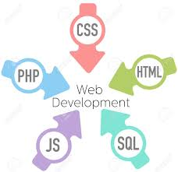
Technology Used

Slide 9
Technology Used
HTML : It is used by developers to define structure of the webpage. Every page you see on browser is written using HTML. Web-Browser read and understand the markup text in HTML.
CSS : CSS stands for Cascading Style Sheets. To define style of the Web Page that is, type of font, its size, background-color etc. ,we use CSS. Using CSS, you can define, how each element of your web-page should look. Browser read HTML and CSS together to define the web page.
In this Project, we Use External style sheets named file as “ style.css”

Slide 10
Bootstrap : Bootstrap is like external CSS file that we will link to our HTML page to apply various styles. We use Bootstrap, we don’t have to write style statements again and again. Bootstrap has various pre-defined CSS classes. We just need to include the name of the class and the style gets applied . This makes web development easier.
JavaScript : JavaScript is a client-side scripting language of web developed by Netscape in 1995 with the name LiveScript. JavaScript is used to build interactive websites with dynamic features and to validate form data. JavaScript is high-level, dynamic and browser interpreted programming language, supported by all modern web browsers. Apart from web browser, JavaScript is also used to build scalable web applications using Node JS. JavaScript is also being used widely in game development and Mobile application development.

Slide 11
PHP: PHP is a server-side scripting language. That is used to develop Static websites or Dynamic websites or Web applications. PHP stands for Hypertext Pre-processor, that earlier stood for Personal Home Pages.
PHP scripts can only be interpreted on a server that has PHP installed.
The client computers accessing the PHP scripts require a web browser only.
A PHP file contains PHP tags and ends with the extension ".php".
SQL: SQL is a database computer language designed for the retrieval and management of data in a relational database. SQL stands for Structured Query Language. SQL is Structured Query Language, which is a computer language for storing, manipulating and retrieving data stored in a relational database. SQL is one of the most widely used query language over the databases.
In this project ,we have used XampServer as local server for storing our database.

Slide 12
SOME SCREENSHOTS
FROM THE WEBSITES

Slide 13
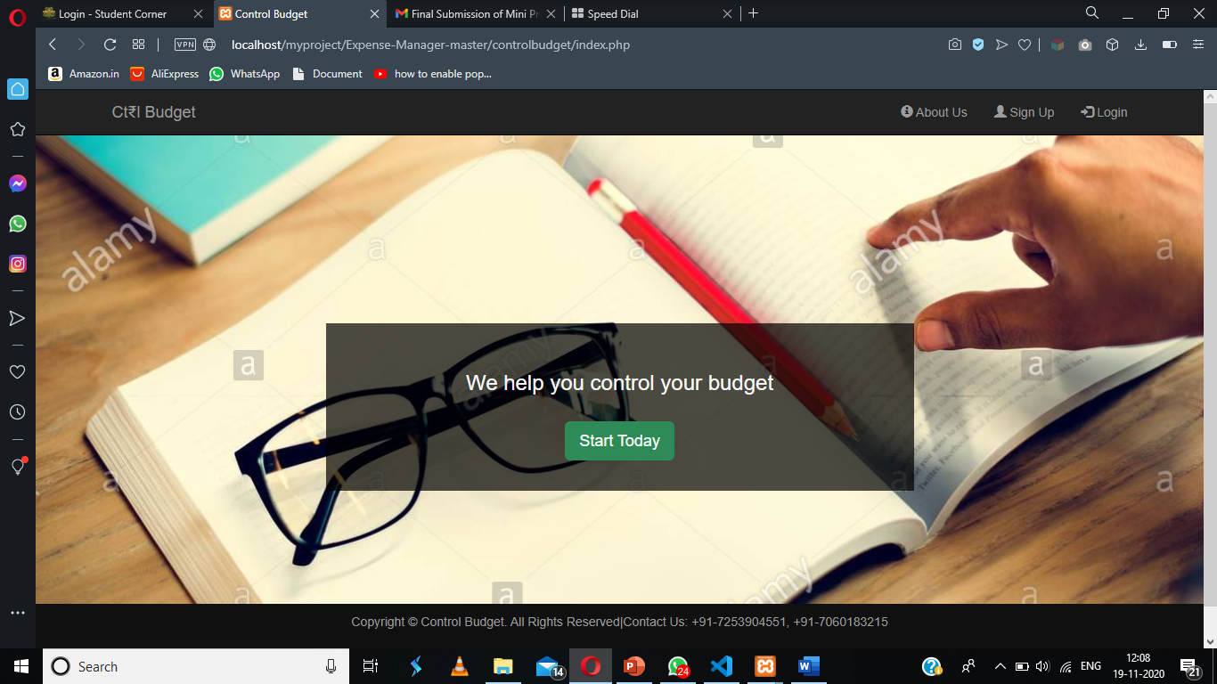

Slide 14
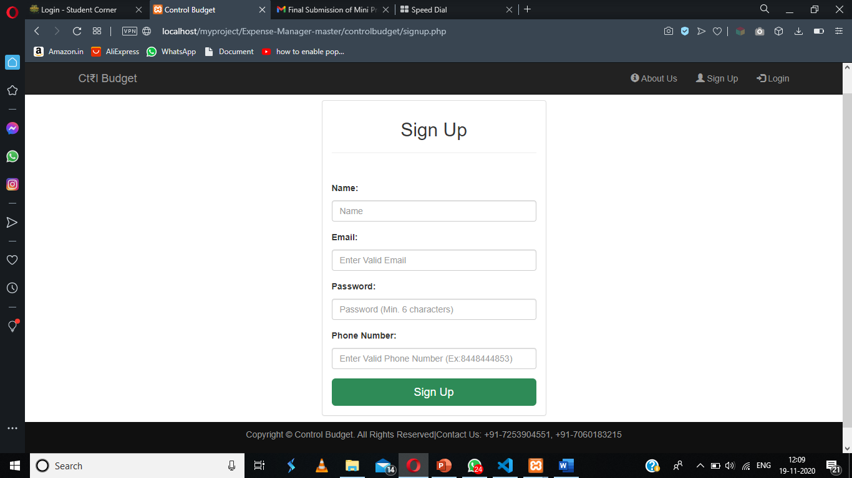

Slide 15
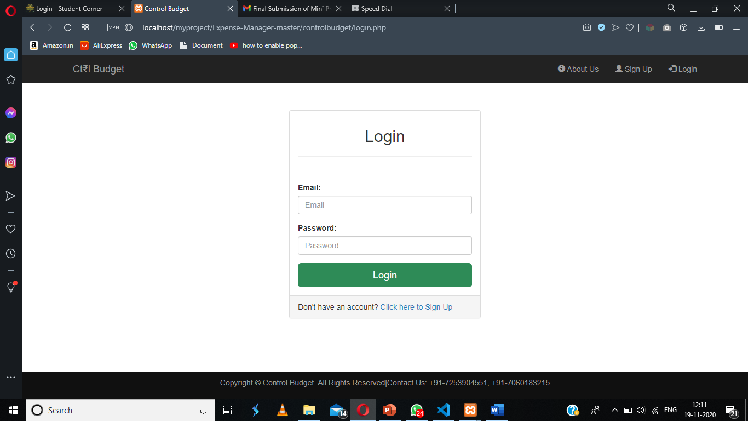

Slide 16
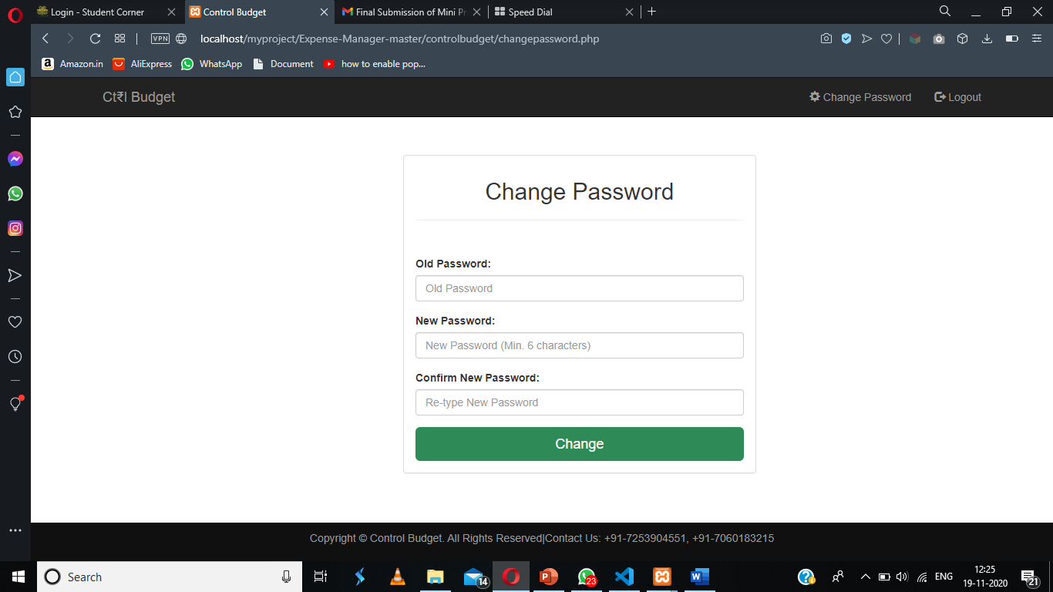

Slide 17
Advantages
User friendly Interface.
User can easily manage budget and track it accordingly.

Slide 18
Limitations
• You must need a Local server for storing the database at the backend.
People who are not familiar with computers or using online websites can’t use this software
There is always a scope of improvement in the software so in this also, like we will like to improve its user interface, add more features e.t.c.

Slide 19
Thank
You…

